Slide 1

Menu
About Us
@reallygreatsite
E-Commerce Website Project

Slide 2
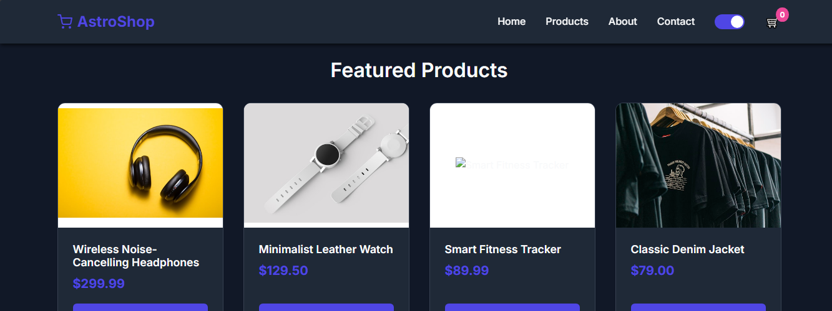
Menu
About Us
@reallygreatsite
A simple online shopping website
Users can browse products
View product details
Add products to the cart
Proceed to checkout

Slide 3


Menu
About Us
@reallygreatsite
Project Pages
Home Page
Products Page
Product Details Page
Cart Page
CheCkout Page
About Page
Contact Page

Slide 4
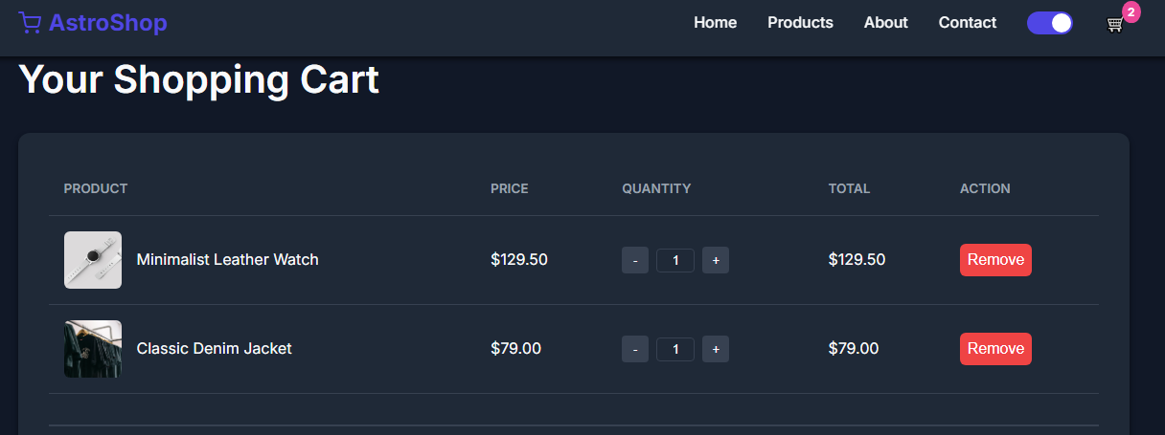
Menu
About Us
@reallygreatsite
How the System Works
User opens the website
Browses available products
Selects a product
Adds it to the cart
Proceeds to checkout

Slide 5
Menu
About Us
@reallygreatsite
Future Improvements
User login system
Online payment options
Admin dashboard
Add database integration

Slide 6

Menu
About Us
@reallygreatsite
Main Features
Browse products
View product details
Add products to cart
Checkout process
About and Contact pages

Slide 7
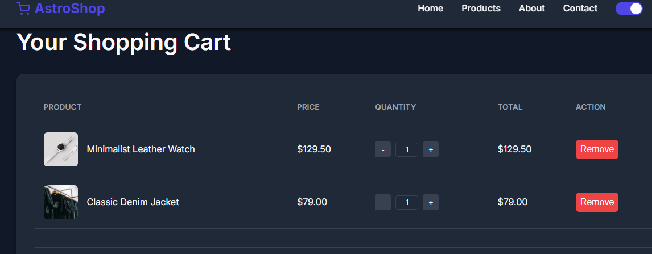
Menu
About Us
@reallygreatsite
HTML → Website structure
CSS → Design and layouT
Technologies Used
JavaScript → Interactivity and cart system

Slide 8
Menu
About Us
@reallygreatsite
conclusion
Demonstrates basic e-commerce functionality
Built using front-end technologies
Helps understand website interaction

Slide 9



Menu
About Us
@reallygreatsite
thank you
123 Anywhere St.
+123-456-7890
@reallygreatsite

